Slide 1
BCX2022: Driving Score Team: 11_42_microBosch
November 2022

Slide 2

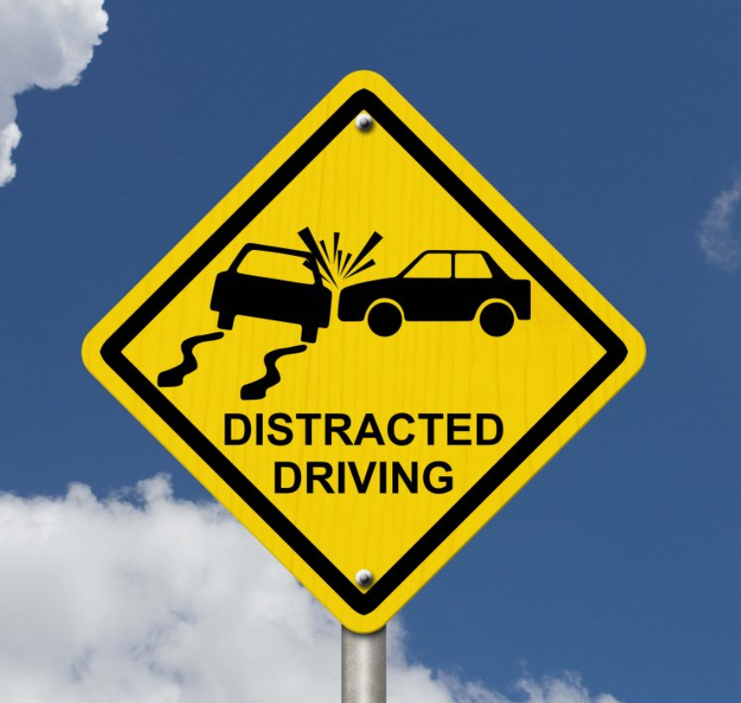
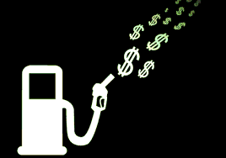
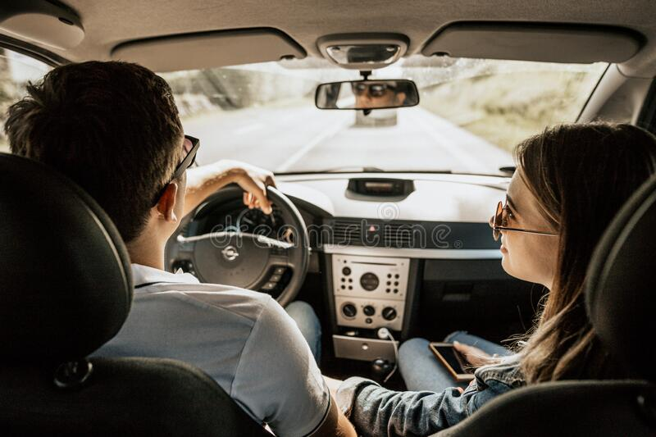
Motivation
Fuel economy
Safety Driving
Comfortable transportation

Slide 3
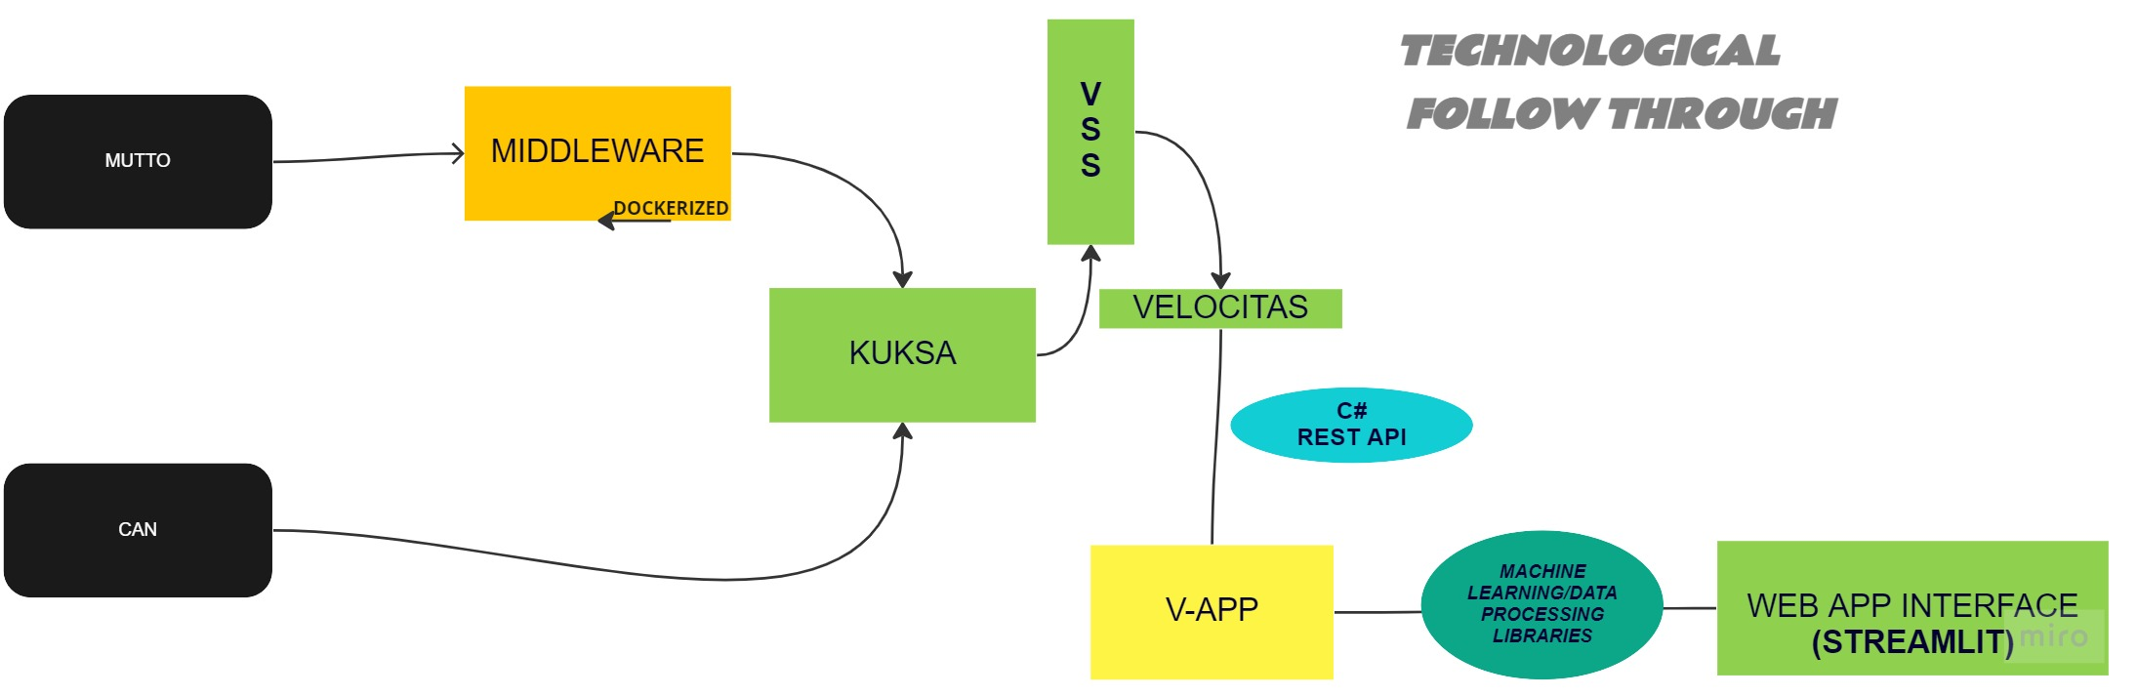
Stack and used Technologies

Slide 4
Interface
Demo

Slide 5


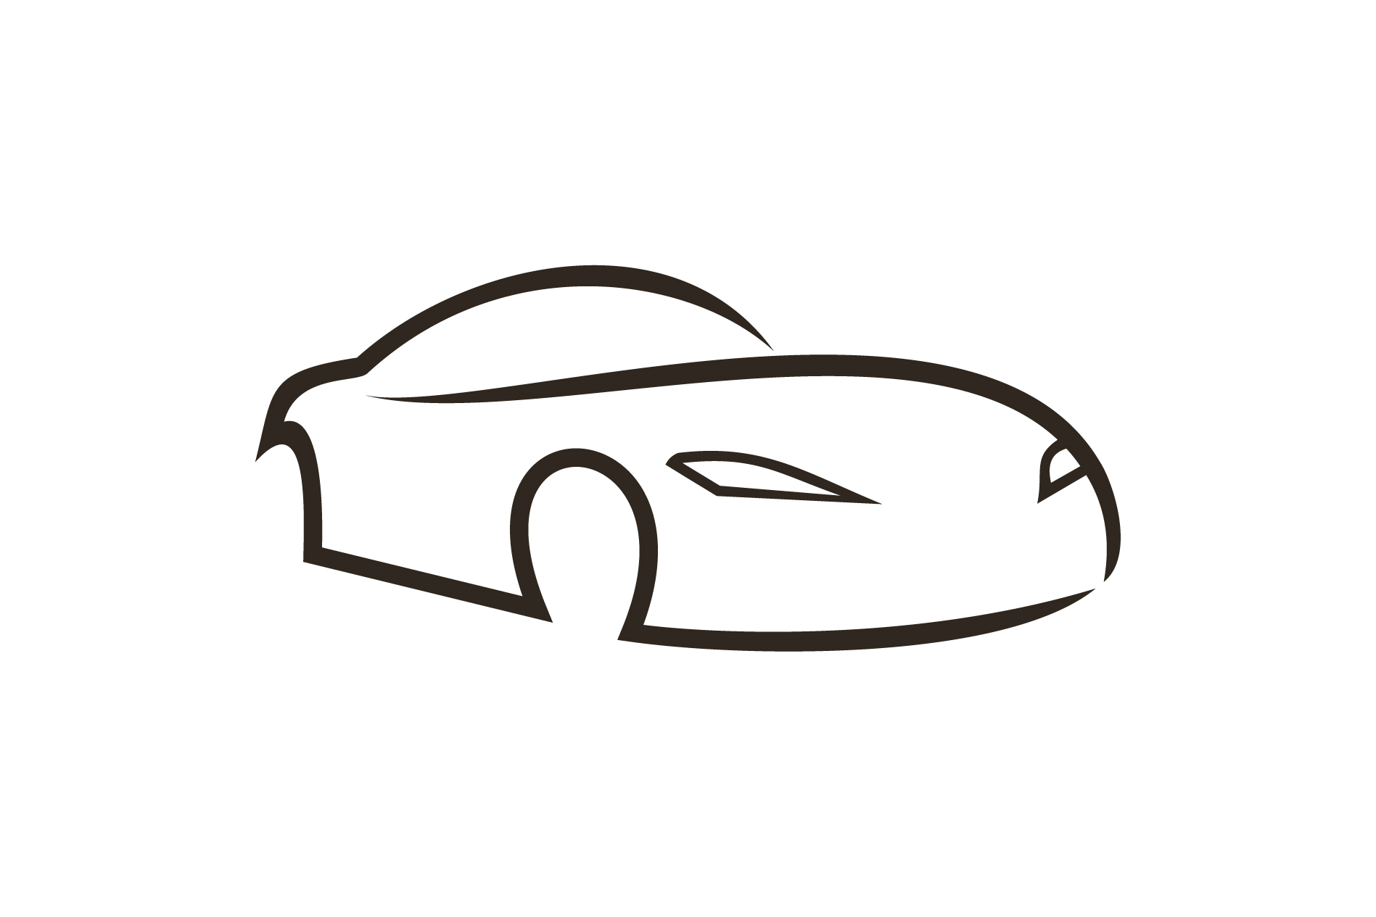


Impact
Public transport
taxi
Car sharing
Your Car
Comfort transportation
Exclusion of bad drivers
Drive culture

Slide 6

Thanks for your attention!

